Slide 1
M.A.M COLLEGE OF PHARMACY, KESANUPALLI, NARASARAOPET
A One Week Faculty Development Program
on
“Computational Approaches Applied to Drug Discovery and Drug Product Development”
16-05-2022 to 22-05-2022
RESOURCE PERSON:
Dr.Y.Narasimha Rao, M.Pharm.,PhD
Professor and HOD
Department of Pharmacology

Slide 2
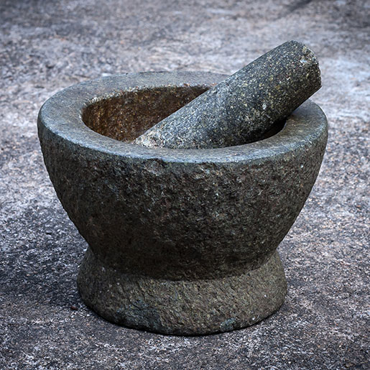
EVIDENCE BASED AYURVEDA DRUG DEVELOPMENT PROCESS

Slide 18
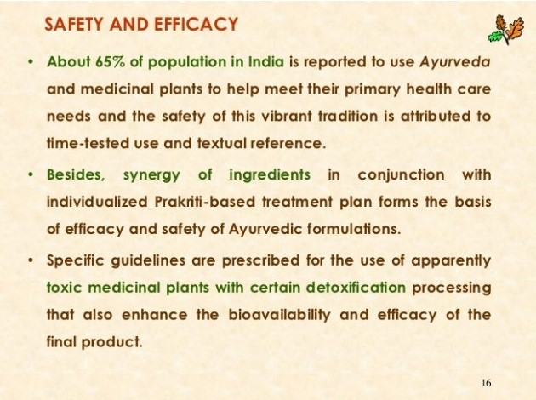

Slide 45
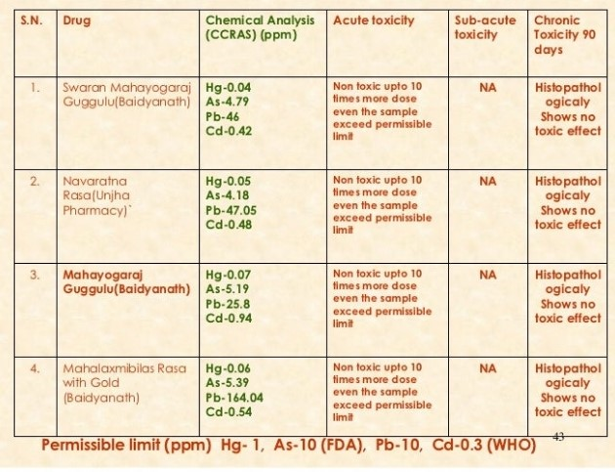

Slide 51
